Slide 1


Introduction
COMPSCI 453 Computer Networks
Professor Jim Kurose
College of Information and Computer Sciences
University of Massachusetts
Overview. What is the Internet? What is a protocol?
Network edge
Network core
Performance: loss, delay, throughput
Protocol layers, service models
Security
History
Class textbook:
Computer Networking: A Top-Down Approach (8th ed.)
J.F. Kurose, K.W. Ross
Pearson, 2020
http://gaia.cs.umass.edu/kurose_ross

Slide 2

Chapter 1: introduction
Chapter goal:
Get “feel,” “big picture,” introduction to terminology
more depth, detail later in course
Overview/roadmap:
What is the Internet? What is a protocol?
Network edge: hosts, access network, physical media
Network core: packet/circuit switching, internet structure
Performance: loss, delay, throughput
Protocol layers, service models
Security
History

Slide 3
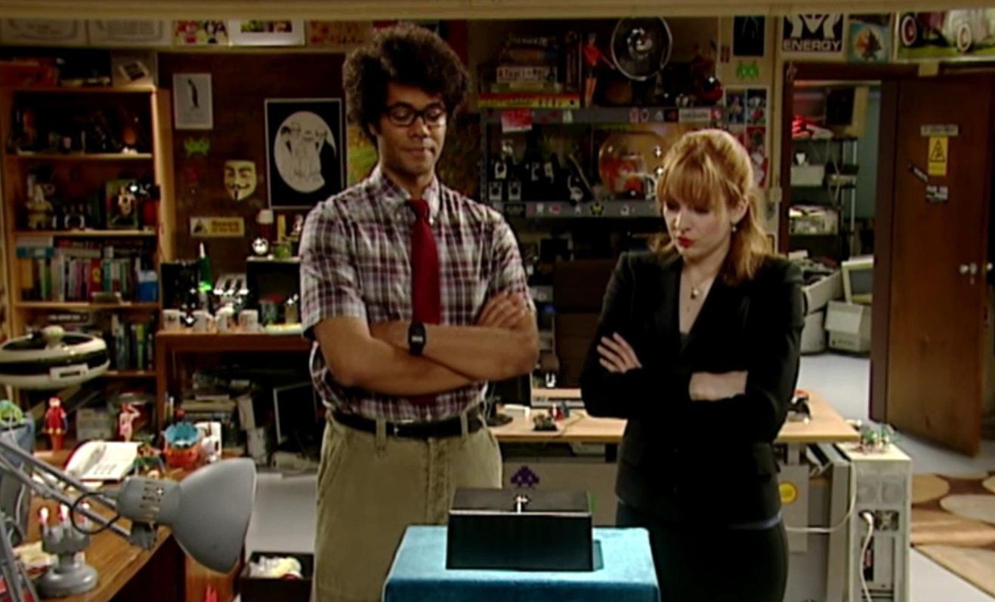

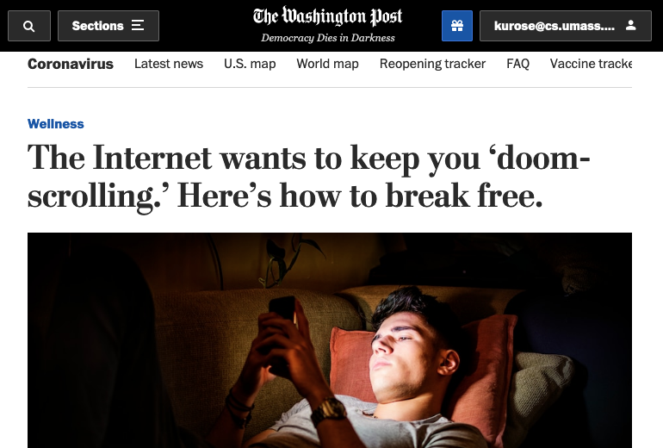
What is the Internet?
https://www.youtube.com/watch?v=iDbyYGrswtg
https://www.youtube.com/watch?v=ourb9j-dq8Q

Slide 4
















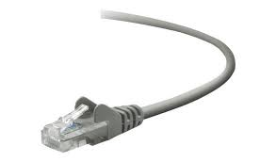
The Internet: a “nuts and bolts” view
Billions of connected computing devices:
hosts = end systems
running network apps at Internet’s “edge”
mobile network
national or global ISP
Packet switches: forward packets (chunks of data)
routers, switches
local or regional ISP
Internet
Communication links
fiber, copper, radio, satellite
transmission rate: bandwidth
home network
content
provider
network
datacenter
network
Networks
collection of devices, routers, links: managed by an organization
enterprise
network

Slide 5


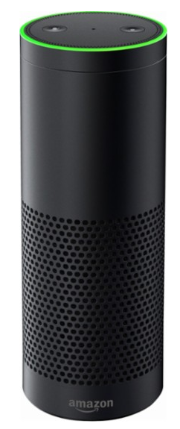

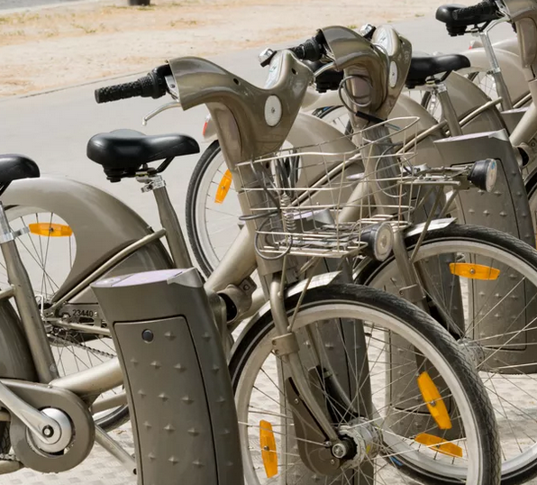

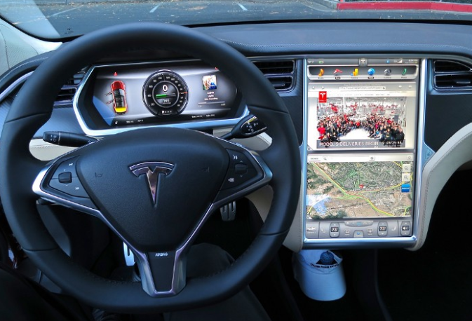


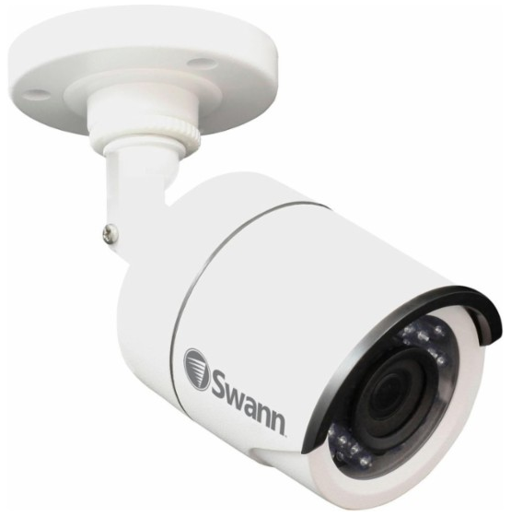
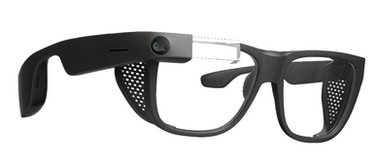

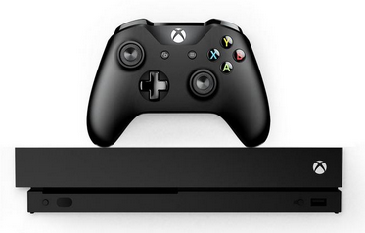

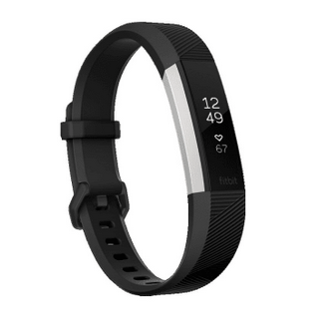

“Fun” Internet-connected devices
Tweet-a-watt:
monitor energy use
bikes
Pacemaker & Monitor
Amazon Echo
Web-enabled toaster +
weather forecaster
IP picture frame
Internet
refrigerator
Slingbox: remote
control cable TV
cars
Security Camera
AR devices
sensorized,
bed
mattress
scooters
Others?
Gaming devices
Internet phones
Fitbit

Slide 6
The Internet: a “nuts and bolts” view
mobile network
4G
Internet: “network of networks”
Interconnected ISPs
national or global ISP
protocols are everywhere
control sending, receiving of messages
e.g., HTTP (Web), streaming video, Skype, TCP, IP, WiFi, 4G, Ethernet
IP
Streaming
video
Skype
local or regional ISP
home network
content
provider
network
Internet standards
RFC: Request for Comments
IETF: Internet Engineering Task Force
HTTP
datacenter
network
Ethernet
TCP
enterprise
network
WiFi

Slide 7
The Internet: a “services” view
Infrastructure that provides services to applications:
Web, streaming video, multimedia teleconferencing, email, games, e-commerce, social media, inter-connected appliances, …
mobile network
national or global ISP
Streaming
video
Skype
local or regional ISP
provides programming interface to distributed applications:
“hooks” allowing sending/receiving apps to “connect” to, use Internet transport service
provides service options, analogous to postal service
home network
content
provider
network
HTTP
datacenter
network
enterprise
network

Slide 8
What’s a protocol?
Human protocols:
“what’s the time?”
“I have a question”
introductions
Network protocols:
computers (devices) rather than humans
all communication activity in Internet governed by protocols
Rules for:
… specific messages sent
… specific actions taken when message received, or other events
Protocols define the format, order of messages sent and received among network entities, and actions taken on message transmission, receipt

Slide 9



What’s a protocol?
A human protocol and a computer network protocol:
Hi
TCP connection
request
Hi
TCP connection
response
Got the
time?
GET http://gaia.cs.umass.edu/kurose_ross
2:00
<file>
time
Q: other human protocols?
Notes:
Explain important points
distributed entities, exchanging messages (governed by protocols)
Time going down
go over definition of protocol (showing format, order of messages sent and received, and actions taken)
We’ll see these kinds of diagrams a lot

Slide 10

Introduction
COMPSCI 453 Computer Networks
Professor Jim Kurose
College of Information and Computer Sciences
University of Massachusetts
Introduction. What is the Internet? What is a protocol?
Network edge
Network core
Performance: loss, delay, throughput
Protocol layers, service models
Security
History
Class textbook:
Computer Networking: A Top-Down Approach (8th ed.)
J.F. Kurose, K.W. Ross
Pearson, 2020
http://gaia.cs.umass.edu/kurose_ross
Video: 2020, J.F. Kurose, All Rights Reserved
Powerpoint: 1996-2020, J.F. Kurose, K.W. Ross, All Rights Reserved

